Slide 1
Preparing for ‘SIP 2.0’
PRME UK and Ireland Chapter Friday 8 March 2024 [Updated 3 July 2024 – Additional information has been provided by the PRME Secretariat to enhance clarity, inc. in relation to who is due to report when. The only change to a specific question is Q9, which now has an additional narrative on internal communications]. Laura Steele (laura.steele@qub.ac.uk), UKI Chapter Steering Committee

Slide 2
Transition Timeline & FAQs
The ‘Refreshed’ PRME Principles
PRME Commons Platform
The Terminology
SIP 2.0: The Questions
Q&A
Stay Connected!
Agenda

Slide 3
Transition Timeline
This year, the universal submission period will be 28 March to 31 August 2024.
From 2025, the universal submission period will be 1 March to 30 June annually.
If an institution does not submit, they will be listed as ‘non-communicating’. This can be changed by submitting by 31 December.
On 28 March, the key contact for every Signatory will receive an invitation to join the PRME Commons.
Please ensure that the contact details the PRME Secretariat holds for your school are correct.
You can view and update these via your profile on the PRME website. If you cannot access your profile, please email info@unprme.org
There will be webinars on reporting held throughout this period by both the PRME Secretariat and the UK & I Chapter. There will be a ‘walk-through’ of the PRME Commons on Thursday 28 March at 1pm GMT.

Slide 4
FAQs
How often do we need to report?
Annually (between 28 March and 31 August in 2024, then between 1 March and 30 June from 2025 on).
Who does the process apply to?
All PRME Signatories who had SIP reports due in 2024, except for new joiners, meaning those that joined PRME in 2023 and 2024. New joiners will submit their first SIP Report under the new process during the March-June 2025 submission period.
Early adopters of SIP 2.0 will not be due to submit another report, regardless of their original SIP deadline, until the March- August 2025 submission period.
Any Signatories that submitted SIP reports in 2023 are not due to submit until 2025. Full details are available here.
Where can I view the questions?
You can view the questions here (and in this slide deck).
When can I access the Platform?
From 28 March 2024; however, you can see a preview here.
Are all questions mandatory?
Signatories will be asked all questions, but you can indicate if they do not apply to your institution or if the data is not available.
Notes:
This new reporting process will apply to all PRME Signatories beginning in 2024, except for new joiners, meaning those that joined PRME between August 2023 and August 2024. New joiners will submit their first SIP Report under the new process during the March - June 2025 submission period.
There will be a phased approach for those that are due to submit a SIP Report in 2023 and 2024 under the traditional SIP Reporting process. While we encourage you to submit in 2024, you may qualify to start annual reporting in 2025. Please reach out to info@unprme.org for more information.
If you submitted a SIP report in 2023, you are encouraged to submit in 2024 but you are not required to submit until 2025. If you were due to submit in 2023 but did not, you have likely been extended to 31 August 2024 and should submit under the SIP 2.0 this year.
If you joined PRME between January - August 2022, you are required to submit during the universal reporting period 28 March - 31 August 2024. If you joined or reported between September and December 2022, you are highly encouraged to submit in 2024 but will not be required until the universal reporting period in 2025.
Early adopters of SIP 2.0 will not be due to submit another report, regardless of their original SIP deadline, until the March - August 2024 submission period.

Slide 5
The Seven Principles
PURPOSE
We advance responsible management education to foster inclusive prosperity in a world of thriving ecosystems.
PARTNER
We engage people from business, government, civil society, and academia to advance responsible and accountable management education and practice.
VALUES
We place organizational responsibility and accountability to society and the planet at the core of what we do.
PRACTICE
We adopt responsible and accountable management principles in our own governance and operations.
TEACH
We transform our learning environments by integrating responsible management concepts and practices into our curriculum and pedagogy.
SHARE
We share our successes and failures with each other to enable our collective learning and best live our common values and purpose.
RESEARCH
We study people, organizations, institutions, and the state of the world to inspire responsible management and education practice.

Slide 6
Commons
A comprehensive digital platform to support PRME’s work in
CREATING
ORGANIZING
SHARING
Responsible Management Education content and SIP reporting to foster
You can take a ‘sneak peek’ at the Commons here.
COLLABORATION
COMMUNICATION
RECOGNITION
within the global RME community.

Slide 7
The Commons
PROGRESS
Layer 3
PRME SIP dashboard with unique institutional profile
INFORMATION
Library of educational & pedagogical materials
Layer 2
PRME Resource Sharing Community
Peer to peer learning with continuous content improvement
SHARING
Layer 1
PRME self-reporting tool (SIP 2.0) and repository

Slide 8
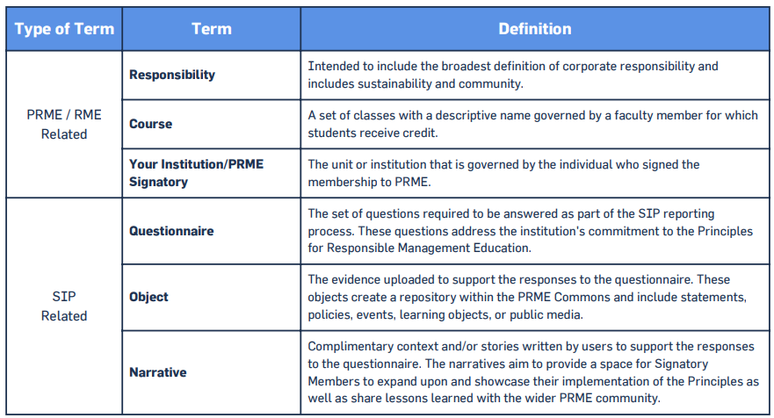
The Terminology

Slide 9
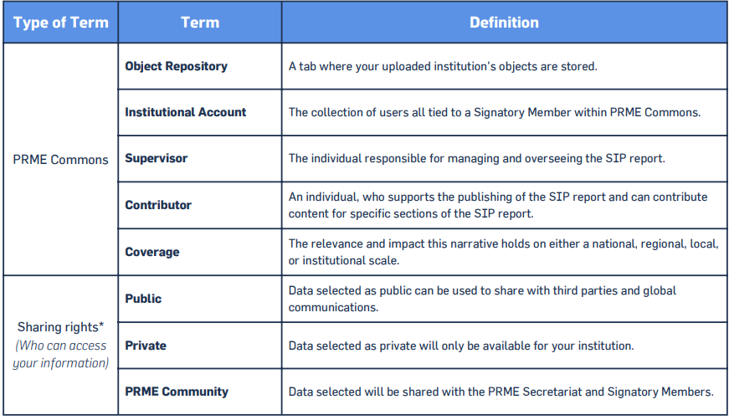
The Terminology

Slide 10
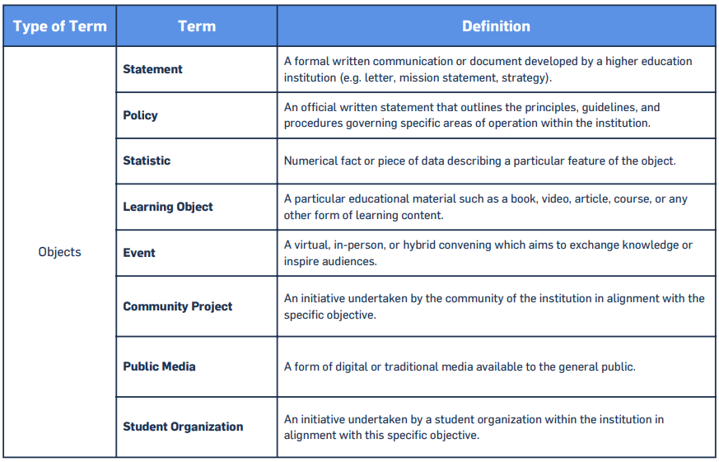
The Terminology

Slide 11
The Terminology

Slide 12
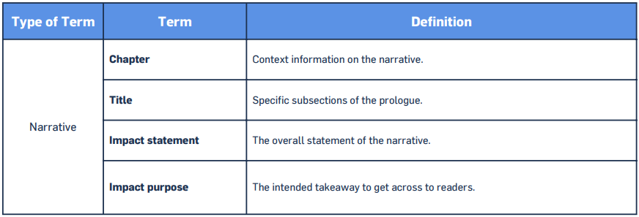
The Terminology

Slide 13
Overview

Slide 14
Notes

Slide 15
Notes

Slide 16
Notes

Slide 17
Notes

Slide 18
Notes

Slide 19
Notes

Slide 20
Notes

Slide 21
Notes

Slide 22
Notes

Slide 23
Notes

Slide 24
Notes

Slide 25
Notes

Slide 26
Notes

Slide 27
Notes

Slide 28
Notes

Slide 29
Notes

Slide 30
Notes

Slide 31
New Question!
This allows you to provide some additional detail about internal communications on RME.
Notes

Slide 32
Stay Connected!
PRME Global
Website: www.unprme.org
LinkedIn: www.linkedin.com/company/principles-for-responsible-management-education-prme
Twitter: @PRMESecretariat
YouTube: www.youtube.com/user/PRMEUN/feed
Facebook: www.facebook.com/unprme
PRME UK & Ireland Chapter
Website: www.unprme.org.uk
LinkedIn: www.linkedin.com/company/prme-uk-ireland-chapter
Twitter: @PRME_UKI
Natascha Radclyffe-Thomas (British School of Fashion), Chapter Chair: Natascha.Radclyffethomas@gcu.ac.uk
Laura Steele (Queen’s Business School), Vice-Chair: laura.steele@qub.ac.uk
Image: University of Exeter (2023)

Slide 33
www.unprme.org
name@unglobalcompact.org

